Slide 1
Introduction
Welcome to the presentation
Today, we will compare NoSQL and SQL databases
Let's dive into the world of databases!

Slide 2
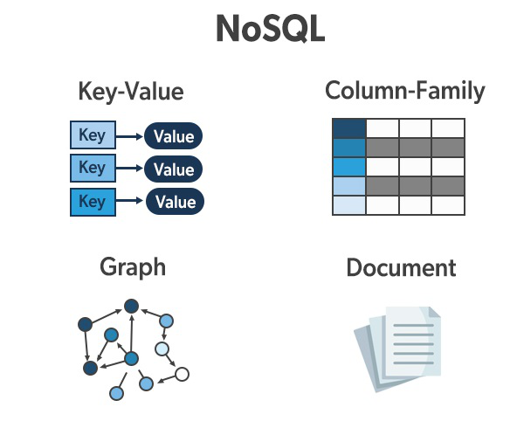
NoSQL Database
Stores data in a non-tabular format
NoSQL stands for 'Not Only SQL'
Flexible and schema-less
Document-oriented, key-value, graph, or wide-column stores
Scales horizontally with ease

Slide 3
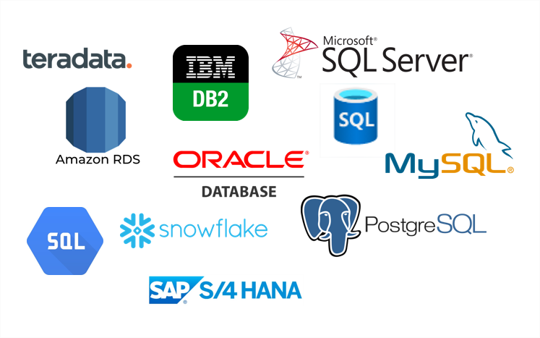
SQL Database
SQL stands for 'Structured Query Language'
Uses a fixed schema and tables
Stores data in a tabular format with rows and columns
Traditional and relational database management system
Scales vertically by adding more resources

Slide 4
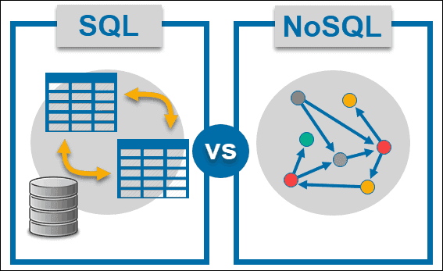
Functionality Comparison
NoSQL is best suited for unstructured and rapidly-changing data
SQL excels in handling structured and well-defined data
NoSQL databases are highly scalable and faster for large datasets
SQL databases are better for complex queries and transactions
NoSQL databases are schema-flexible, allowing easy schema evolution
SQL databases ensure data consistency with ACID (Atomicity, Consistency, Isolation, Durability)

Slide 5

Visual Comparison
NoSQL Flexible schema
NoSQL Horizontal scalability
NoSQL Faster for large datasets
NoSQL Unstructured data
SQL Fixed schema
SQL Vertical scalability
SQL Better for complex queries
SQL Structured data
SQL ACID compliance

